Slide 1

SDL: Past, Present, and Future
Sam Lantinga and Ryan Gordon

Slide 2
What Is SDL?
Simple DirectMedia Layer
Cross-platform interface for hardware abstraction
  Windows, macOS, Linux, iOS, Android, etc.
Covers audio, video, controllers, and much more
Used by game engines and game/app developers
No, my middle initial isn’t ‘D’
Notes:
SDL takes the complexities of dealing directly with hardware out and lets you focus on your game development.

Slide 3
Who Are We?
Sam Lantinga
  Author of SDL, Software Engineer at Valve Corporation
Ryan Gordon
  Partner in crime, Software Engineer at icculus.org
Unsung heroes
  @1bsyl, @Kontrabant, @madebr, @sezero
And many many more…
Notes:
@1bsyl, Sylvain, handles many miscellaneous cleanups and Android bug reports
@Kontrabant, Frank, is our resident Wayland guru
@madebr, Maartin, is our resident CMake guru
@sezero, Ozkan, makes sure our i‘s are dotted and t’s crossed

Slide 4
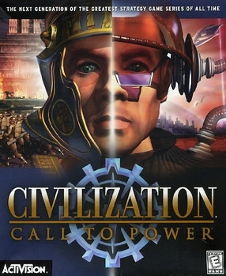
The Past: SDL 1.2
Born out of Executor, a 68k Macintosh emulator
Single window, framebuffer access, single audio callback, keyboard/mouse/joystick input, CD-ROM support
Used by Loki Software in Linux ports

Slide 5
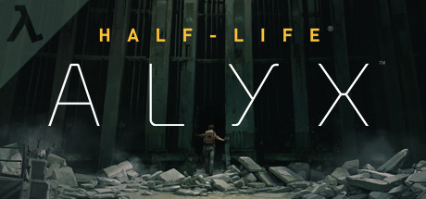
The Present: SDL 2.0
Added support for multiple windows, surround sound, accelerated 2D video API, Vulkan graphics context, game controller API
Used by Valve Corporation in Steam and the Source 2 engine across all platforms

Slide 6
25 Years of History
Started with Loki Software in 1998
  Civilization: Call To Power, Heroes of Might and Magic III, Sid Meier’s Alpha Centauri, Tribes 2, Unreal Tournament, etc.
Continues with Valve Corporation in 2023
  DOTA 2, Half-Life: Alyx, Portal 2, Steam, Steam Link, Steam VR, Team Fortress 2, etc.
Used by hundreds of games, including many published on Steam
Used by several major game engines, including Unity and Source 2
Used by games, emulators, embedded environments, and more!
Has bindings for over a dozen programming languages
Notes:
* SDL is actually used in Source 1 as well, but only on Linux and for controller support. SDL is fully used for all platforms in Source 2.

Slide 7
25 Years of Portability
Windows, Linux, *BSD, macOS, iOS, tvOS, Android
Windows RT, Windows UWP, Windows and Xbox GDK
Playstation, Nintendo Switch
Emscripten: reimplemented SDL 1.2 API using Javascript, now directly supported in SDL 2.0
And many more over the course of time… Haiku, N3DS, OS/2, PS Vita, QNX, etc.

Slide 8
Open Source Is Great
Moving to GitHub has greatly increased developer engagement and feedback, and has directly contributed to the move to SDL 3
There are over 400 contributors and 1000 forks of the core library
Moving to GitHub has made it much easier to release quickly, and now we have a monthly cadence of stable release updates
Notes:
* SDL has always been open source, it started out as LGPL and then moved to the Zlib license.

Slide 9
Commercial Products Are Great
Great feedback from professional developers shipping large products
Battle tested, shipping in Steam to millions of customers every day
Used by Steam Link exclusively for audio, video, and input across mobile and desktop platforms
Shipping SDL pre-release code in Steam betas results in more stable releases

Slide 10
The Future: SDL 3.0
Opportunity to apply what we’ve learned over the last 10 years, changing the API and ABI
Simplify and streamline the build process
Simplify and streamline the API
Add new useful functionality

Slide 11
The Future: SDL 3.0
Simplifying and streamlining the build process
  Standardizing on Cmake
  Visual Studio and Xcode projects still available

Slide 12
The Future: SDL 3.0
Simplifying and streamlining the API
  Symbol naming conventions are more consistent
  Simplifying functions where it makes sense
  Removing functions where it makes sense
  main() handling moved to a standalone header library

Slide 13
The Future: SDL 3.0
Adding new useful functionality
  New 3D GPU API in development
  Full support for high DPI displays
  Added nanosecond time precision
  Added sub-frame event timing
  And much, much more!

Slide 14
The Compatibility Story
Compatibility is important so older commercial games continue to run as platforms evolve
sdl12-compat allows running SDL 1.2 games on the SDL 2.0 runtime
sdl2-compat allows running SDL 2.0 games on the SDL 3.0 runtime
SDL 1.2 => sdl12-compat => sdl2-compat => SDL 3.0 works!
Civilization: Call To Power from 1999 runs seamlessly on a modern Linux system running Wayland

Slide 15
Easing the Transition
Careful decisions about how to change the codebase
  Code style reformatting was applied to both SDL2 and SDL3 so bug fixes could be more easily merged between major versions
  We decided not to switch to stdint types for internal code

Slide 16
Easing the Transition
Careful decisions about how to change the API
  Does the change make life better for developers?
  Are we changing the API in a way that will still make sense 10 years from now?

Slide 17
Easing the Transition
Transition guide
  As part of the change acceptance process, each change must be documented and a developer transition plan provided in docs/README-migration.md
  Coccinelle is a tool that can be used on Linux or on Windows via WSL

Slide 18
Topic: Relative Mouse Motion

Slide 19
Topic: Relative Mouse Motion
When is it useful?
  Camera control in FPS style games
  Dragging the map in RTS or RPG style games
  Precise mouse positioning in emulators
  … etc.

Slide 20
Topic: Relative Mouse Motion
Classic approach:
  Mouse warping - originally used in the id DOOM engine
  Generates additional mouse events
  Deltas are affected by desktop mouse acceleration
  Doesn’t work over Windows Remote Desktop
Notes:
* Warping can also run into problems where you hit the edge of the window, or in rare cases, escape the window
* RDP coalesces mouse updates and if you set position you often won’t get back that same position
* Even locally, Windows will just drop the warp if it comes in exactly when mouse input occurs, and this is a big issue with high resolution mice

Slide 21
Topic: Relative Mouse Motion
SDL_SetRelativeMouseMode()
  Uses raw input instead of mouse warping
  Automatically hides the mouse cursor
  Automatically constrains the mouse to the window
  Provides low level, low latency mouse deltas
  Delta scaling disabled by default for predictable movement
  Works with Windows Remote Desktop (sorta)

Slide 22
Topic: Relative Mouse Motion
Considerations
  Warping the mouse in relative mode does not generate a mouse event, but does change mouse position
  You can save and restore mouse position when enabling and disabling relative mouse mode
  You can change relative motion sensitivity by setting SDL_HINT_MOUSE_RELATIVE_SPEED_SCALE
  You can enable desktop mouse acceleration curves in relative mode by setting SDL_HINT_MOUSE_RELATIVE_SYSTEM_SCALE
Notes:
* On the SDL GDC page we have a link to a code example of accumulating floating point relative motion

Slide 23
Conclusion: Relative Mouse Motion
Don’t use mouse warping!
SDL_SetRelativeMouseMode() is a great way to easily add relative mouse motion to your application

Slide 24
Topic: High DPI Support

Slide 25
Topic: High DPI Support
A tale of screen coordinates, scale, and pixels…
  Screen coordinates, also known as points or device independent pixels, are the size in pixels divided by the display scaling factor
  Screen coordinates are oriented around content physical size
  More pixels means more detail, but not more content
Notes:
* Screen coordinates are also known as points or Device Independent Pixels

Slide 26
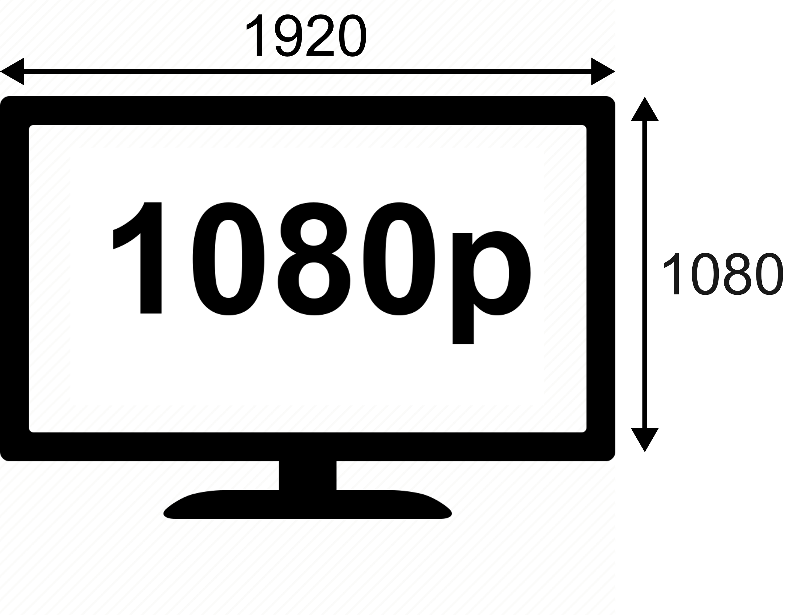
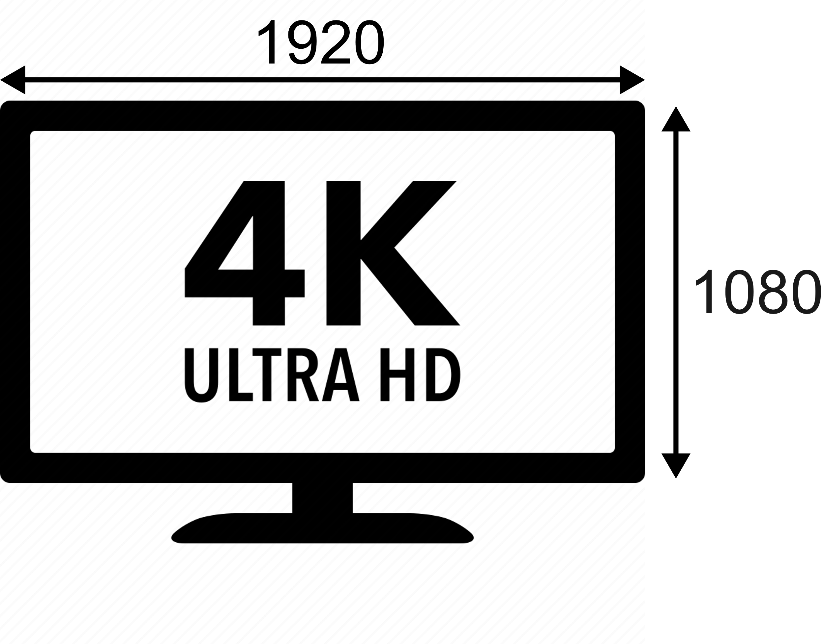
Topic: High DPI Support
A 4K display with 200% scaling has 1080p screen coordinate size
Notes:
* Windows maintain their screen coordinate sizes when moved between displays with different scales or when display scale changes

Slide 27
Topic: High DPI Support
Apple platforms provide screen coordinates, optionally allows high DPI back buffers
Windows provides screen coordinates for non-DPI aware applications, pixels for DPI aware applications
Notes:
* On Apple platforms, scale will always be an integer scale factor. On Windows this will be one of the standard desktop scales, 100%, 125%, 150%, etc.

Slide 28
Topic: High DPI Support
SDL 3.0 applications always get screen coordinates and high DPI back buffers
Display bounds, window coordinates, and mouse coordinates are all specified in screen coordinates
Mouse coordinates are floating point with full precision, centered on pixels
Display modes include size in screen coordinates, size in pixels, and a display scale
Notes:
The display scale will be 1x, 2x, etc. for fullscreen modes, and will be the desktop scale for desktop modes.

Slide 29
Topic: High DPI Support
A fullscreen desktop window is 1920x1080 in both cases, and a 4K back buffer on the 4K monitor

Slide 30
Topic: High DPI Support
SDL_GetDesktopDisplayMode() returns the current desktop mode, including scale
SDL_GetWindowSizeInPixels() returns the size of the back buffer for a window
Notes:
* On the SDL GDC page we have a link to a code example of getting the desktop display scale

Slide 31
Topic: High DPI Support
SDL 2D Render API has convenience functions:
  SDL_SetRenderLogicalPresentation() sets a logical size for the content, rendering to an offscreen texture and then scaling it as needed for presentation
  SDL_RenderCoordinatesToWindow() and SDL_RenderCoordinatesFromWindow() convert between screen coordinates and coordinates in the render viewport
  SDL_ConvertEventToRenderCoordinates() will convert all coordinates in an event into coordinates in the render viewport
Notes:
* SDL_ConvertEventToRenderCoordinates() converts mouse coordinates and touch coordinates

Slide 32
Topic: High DPI Support
High DPI events:
  SDL_EVENT_WINDOW_RESIZED is sent when a window is resized in screen coordinates
  SDL_EVENT_WINDOW_PIXEL_SIZE_CHANGED is sent when the size of a window’s backbuffer has changed, which can happen when moving between high and low density displays
  SDL_EVENT_DISPLAY_SCALE_CHANGED is sent when a display changes scale, which also triggers window pixel size events

Slide 33
Conclusion: High DPI Support
SDL gives you a consistent way of handling high DPI scenarios across all operating systems
Your game should handle floating point mouse coordinates, and window sizes that are different than your back buffer sizes
When you get a pixel size changed event, just rebuild your back buffer
Notes:
You are guaranteed to get a pixel size changed event after your window is created.

Slide 34
Topic: SDL 3.0 GPU API

Slide 35
The 2D problem
SDL's 2D API is limited
Extending it is hard
Even in 2D, the thing people want is shaders

Slide 36
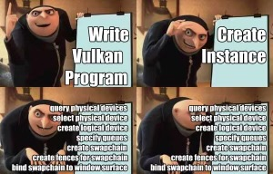
The 3D problem
Most of it is hard to use
Nothing is portable

Slide 37
SDL 3.0 GPU API
Turbo charge SDL's rendering offerings
Offers SDL's focus on simplicity and portability
Built on next-gen APIs
Not required!
Existing 2D API built on top of it

Slide 38
SDL 3.0 GPU Overview
C-callable API offering modern GPU concepts
Command queues, pipelines, PSOs, shaders, fences
Thread safe!
Uses own shader language and bytecode format

Slide 39
Wait, what?
Existing offerings didn't meet portability and simplicity goals
You can use other rendering APIs with SDL if you like!
Transpiling is possible

Slide 40
SDL 3.0 GPU Shaders
Uses own shader language and compiled shader bytecode format
Bytecode is cross-platform: build once, ship everywhere
Shader compiler is small open source C library
Use command line to compile, or embed in your own tools or your own game, to use shader source at runtime!

Slide 41
SDL 3.0 GPU Shading Language
Looks a lot like GLSL, HLSL, MSL, or C
Removed some footguns
Improved some syntax in mostly optional ways
If you’ve ever written a shader, you can handle this
Vertex and pixel shaders for now, more to come

Slide 42
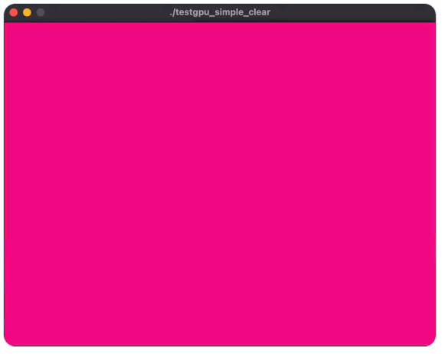
SDL 3.0 GPU Example
The "S" stands for "Simple“
Vulkan: 1157 lines of C.
SDL GPU API: 153 lines (including error checking!)

Slide 43
SDL 3.0 GPU Conclusion
Still early in development, but looking good
Feedback welcome!

Slide 44

Questions?
Presented by Sam Lantinga (slouken@libsdl.org) and Ryan Gordon (icculus@icculus.org)
Slides and code examples at https://www.libsdl.org/gdc2023
Thank you!

